Slide 1

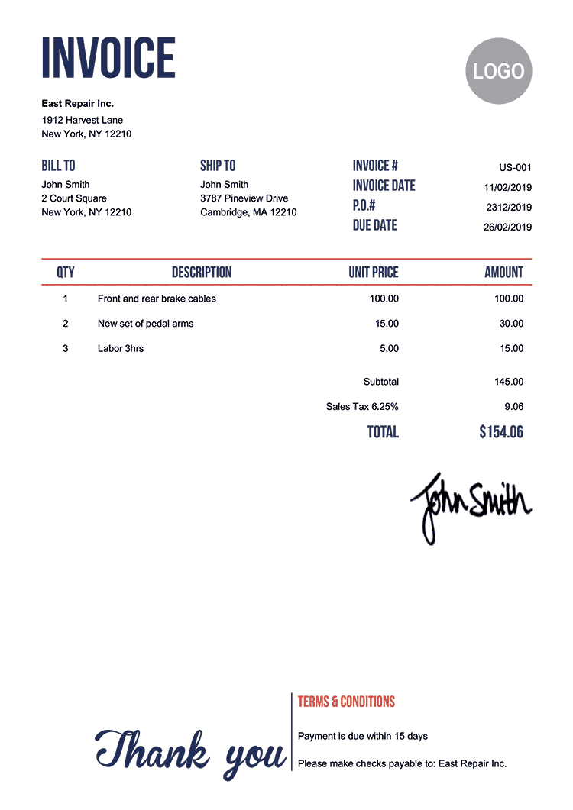

Billing & invoice system for small businesses
For small business owners in need of an invoice system and don’t want to spend too much money outsourcing a vendor to do so
Allows them to update their inventory manually to adjust to their business model
Allows businesses to store invoices digitally instead of having stacks of invoices in a backroom
Prepared by: Isabelle Odutola

